Slide 1
What is the status of my action?
The Certification of Funds Log, located on the NJDOT Intranet will provide you with information on the status of your action.

Slide 2
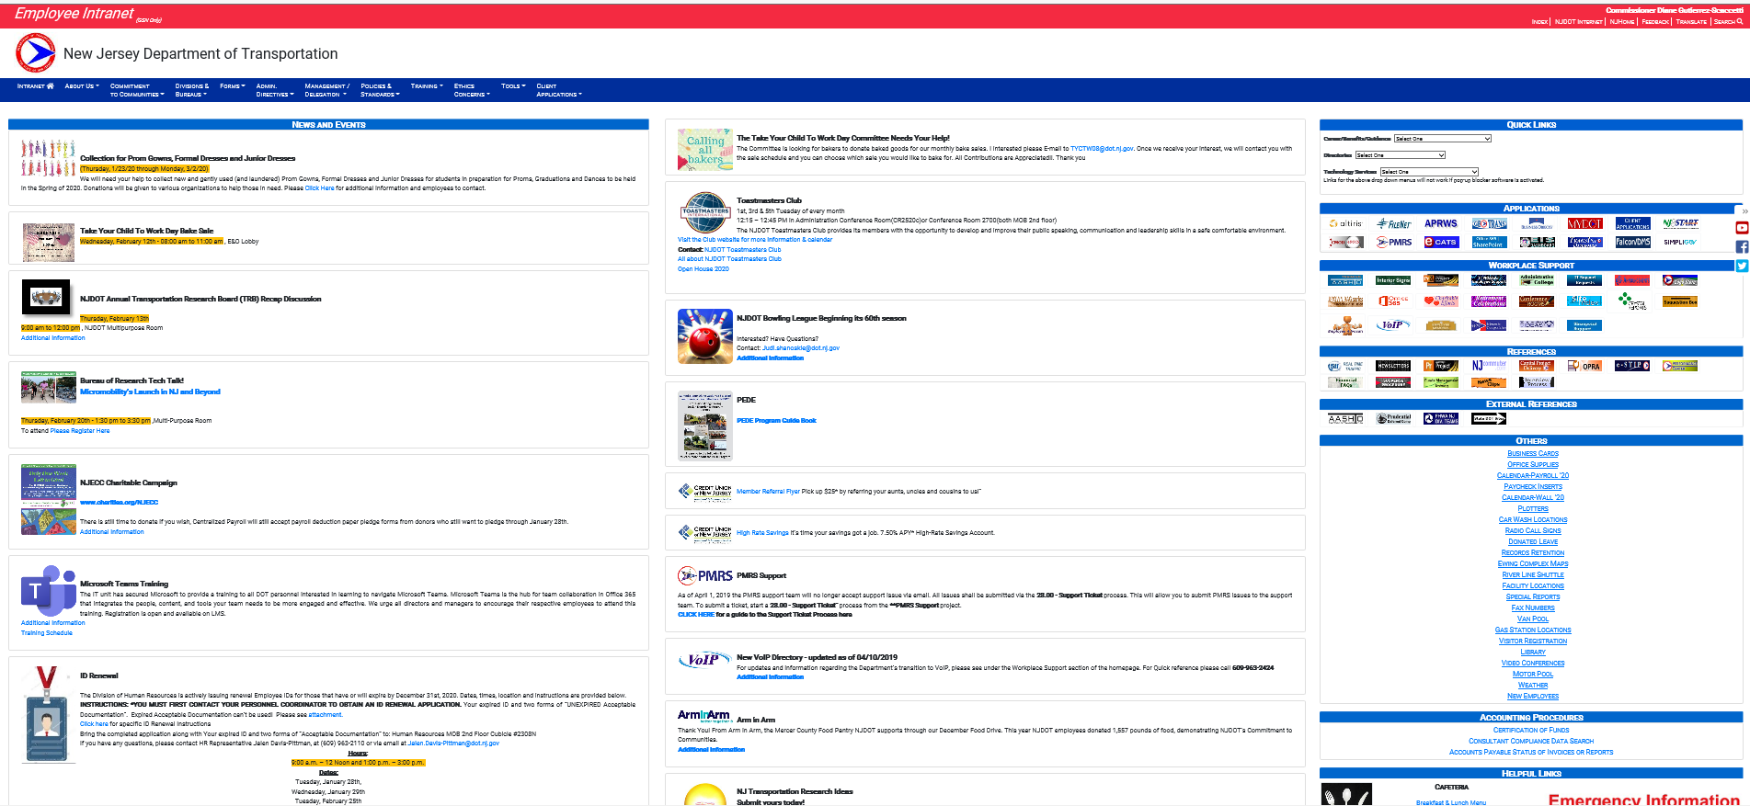
Access the NJDOT Intranet (http://njdotintranet.njdot.lan/) then navigate to “Others”

Slide 3
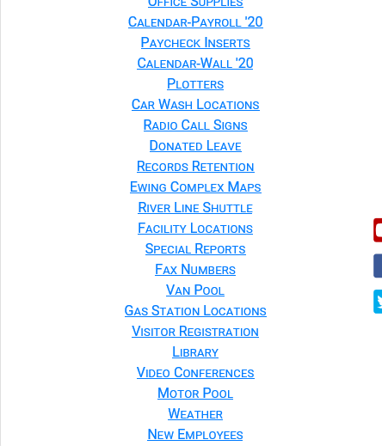
Click on Special Reports

Slide 4
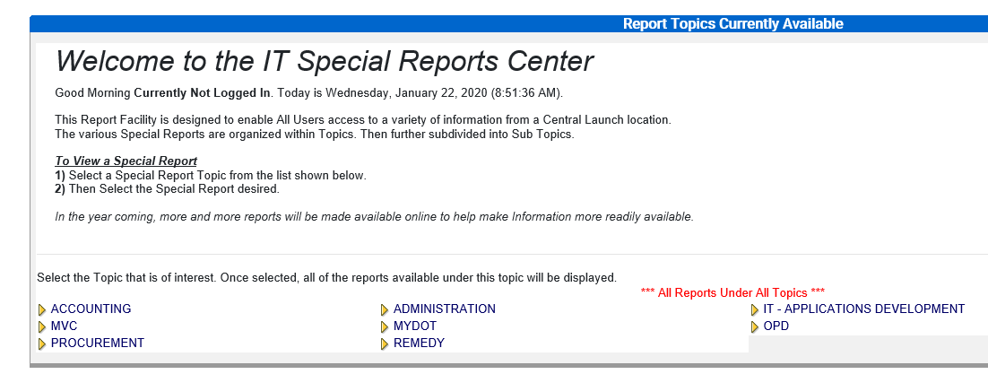
Click on Accounting

Slide 5
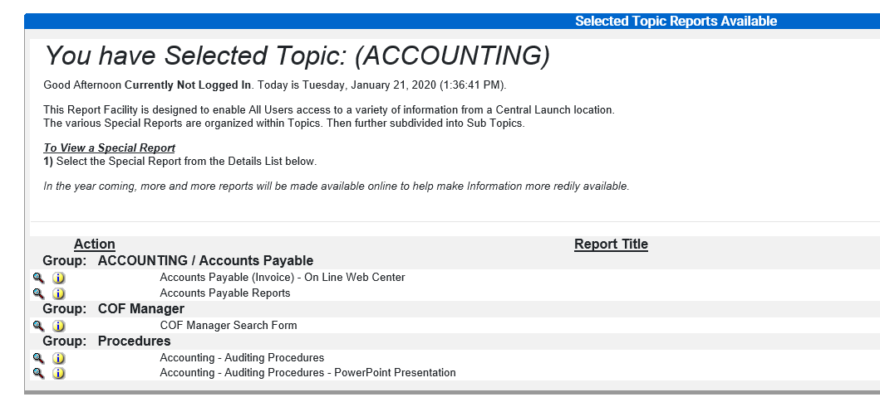
Click on the magnifying glass next to COF Manager Search Form

Slide 6
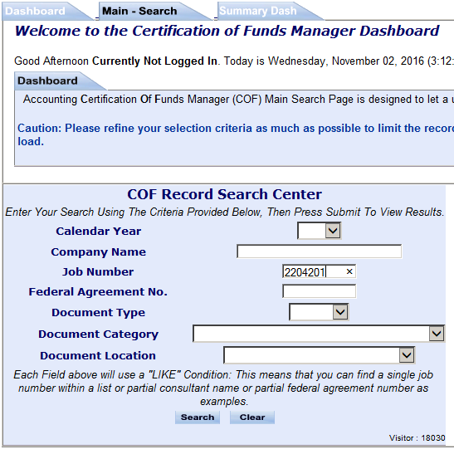
“Locating your documents based on a Job Number“
On the the “Main Search” tab, enter your Job Number as shown below
Click on down arrow for Calendar Year and de-select the year. (ie, the year is now blank.)
Enter Job Number
Click Once On Search

Slide 7
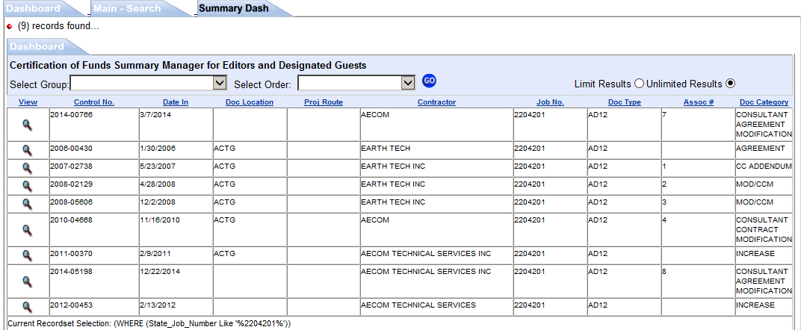
Click on the Spy Glass Next To The Record Of Interest

Slide 8
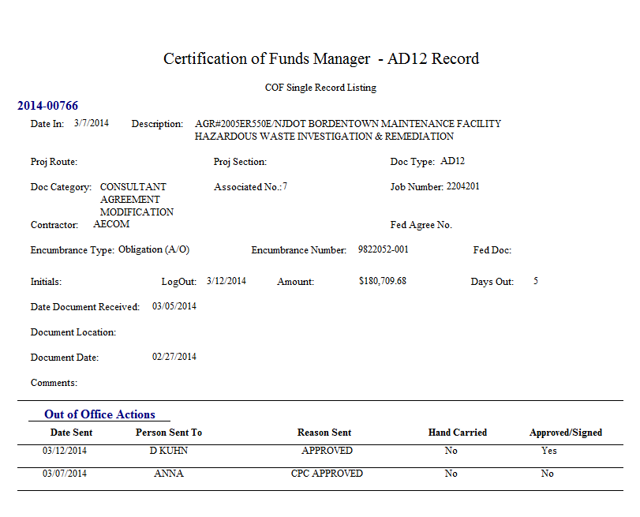
Represents the “control number.” Using the control number in a search provides ease to locating your document.
If the “Date In” is blank, then Accounting has not yet received the action.
Associated Number is the Change Order Number; CCM/CAM Number.
The action is originally keyed in by CPC.
It was approved by CPC on 3/7/2014 and sent to Agreement Accounting. Accounting approved and sent to Dave Kuhn on 3/12/2014.

Slide 9

Questions

